Slide 1
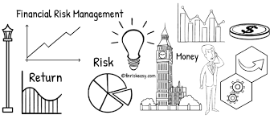
Applying Machine Learning To Financial Risk Management
AITHA SAI PRIYA 18UK1A0501
SRAVANI KARNE 18UK1A0553
GUDIKANDULA BHARATHCHANDRA 18UK1A0574
DONGALA ANJIREDDY 18UK1A0514

Slide 2
INTRODUCTION:
Timely loan repayment along with determining the level of customer reliability is one of the major elements of credit risk assessment. Based on the customer's characteristics credit history analysis and scoring is done. Credit scoring is one of the methods widely used for estimation of the risks associated in granting a loan, or rather the probability of its non-repayment. On the basis of the calculation according to data provided in the loan applications the customer score is obtained which determines the risk levels associated with it. Regardless of how it is calculated and what characteristics taken into account, it eliminates the human factors, adds objectivity to the process which in turn speeds up the process makes it smooth and reduce the risk. Banks usually sanction the loan on the basis of qualitative and quantitative analysis. Based on statistical methods credit scoring helps to predict the probability of a certain events occurring in the future. Credit Scoring models can be classified according to different criteria. Thus, we can talk about a scoring of individuals or companies or credit card, cash or mortgage scoring. The goal of the scoring models for most of the parts is to determine the risk of debt default.

Slide 3
PROBLEM STATEMENT:
Traditional Banking methods have limitations where they cannot analyse large volumes of data and are entirely dependent on credit scores and limited values. These greatly reduce the capability of institutions to reduce risk.
The number of errors that take place on a daily basis in traditional systems is a cause for concern. The cost and manpower required to run this system are immense and it takes a large amount of time for any changes to be implemented in the system.

Slide 4
XGBoost-XGB Classifier
XGBoost is a decision-tree-based ensemble Machine Learning algorithm that uses a gradient boosting framework. In prediction problems involving unstructured data (images, text, etc.) artificial neural networks tend to outperform all other algorithms or frameworks.
XGBoost provides a wrapper class to allow models to be treated like classifiers or regressors in the scikit-learn framework.This means we can use the full scikit-learn library with XGBoost models.The XGBoost model for classification is called XGBClassifier. We can create and and fit it to our training dataset. Models are fit using the scikit-learn API and the model.fit() function.

Slide 5
IBMLearn
Imbalanced-learn (imported as imblearn ) is an open source, MIT-licensed library relying on scikit-learn (imported as sklearn ) and provides tools when dealing with classification with imbalanced classes.
Imbalanced-Learn is a Python module that helps in balancing the datasets which are highly skewed or biased towards some classes. Thus, it helps in resampling the classes which are otherwise oversampled or undesampled. If there is a greater imbalance ratio, the output is biased to the class which has a higher number of examples.

Slide 6
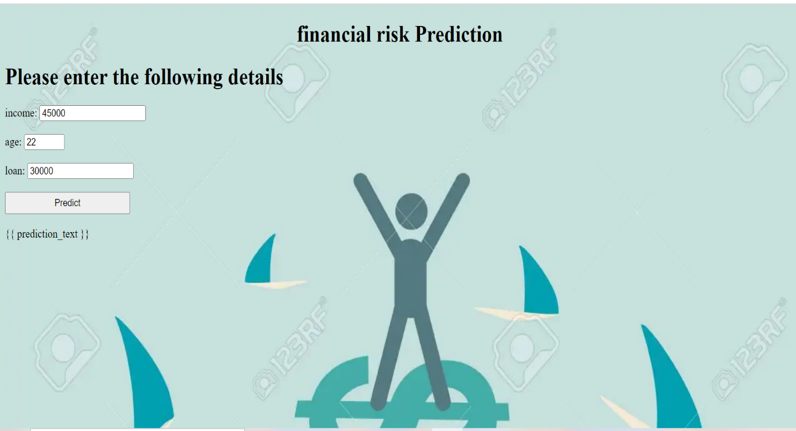
UI Output:

Slide 7
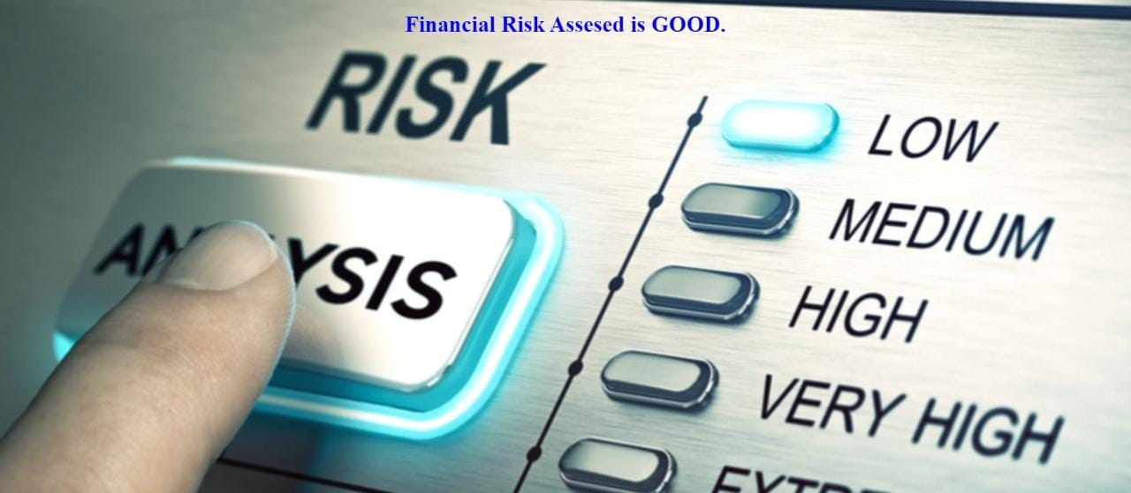
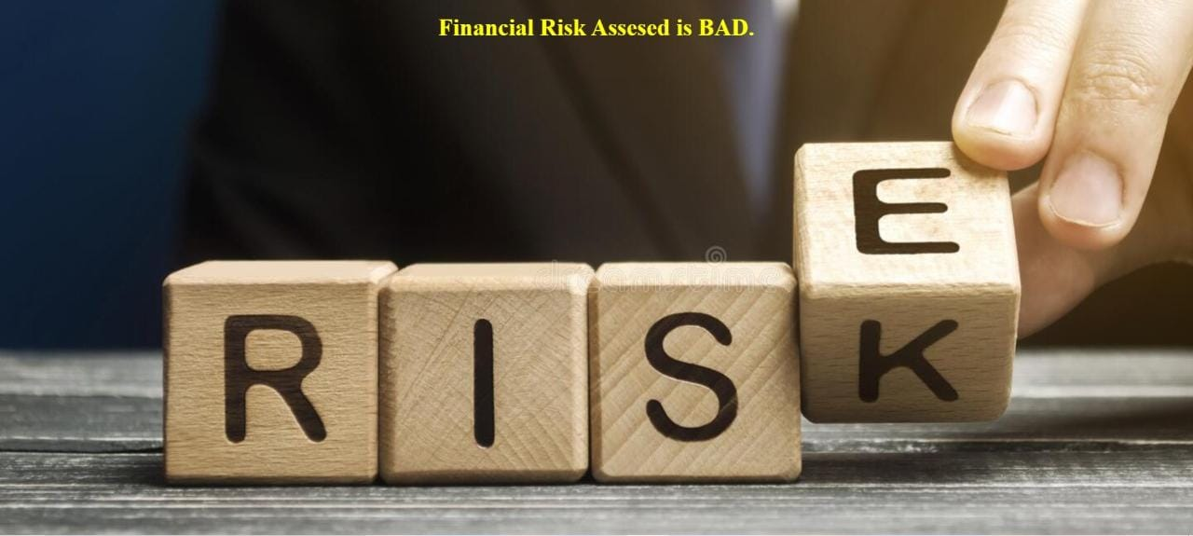
Predictions Based On Inputs Given:

Slide 8
ADVANTAGES:
Scalability: The ML model can easily be scaled up to meet the requirement.
It is quite cost effective as it requires very little capital and can take decisions much faster.
The ML model can easily be changed or modified to accommodate changes in the market.
The automatization of credit risk testing ultimately reduces losses for banks.

Slide 9
DISADVANTAGES:
When using an algorithm, it can be difficult to trust the decision as there is less transparency.
Even with the best algorithm, there are still many human elements to take into consideration.
The effectiveness of an algorithm can reduce with changes in economic factors and will constantly need to be updated and reviewed.

Slide 10
APPLICATIONS:
Our model can help financial institutions determine the credit worthiness of potential customers. By analyzing past spending behaviour and patterns, a system could identify how much credit should be extended to a given customer.
The technology would be especially useful in the case of new customers or those who lack a long credit history, i.e. millennials. Automating credit and risk scoring processes on a mass scale can help banks enhance their credit and risk scoring models across the board.

Slide 11
FUTURE SCOPE:
For accepting or rejecting a loan, a credit scoring model is a tool which is used for decision-making. A credit scoring model is the classification statistical model which is based on the borrower's information, it allows one to distinguish between “good” or “bad” loans. It is just one of the factors used for evaluating a credit application of the borrowers.
Although credit scoring methods are linked applications in banking and finance, they can be widely used in a large variety of other data analytics problems, such as:
Factors which can contribute to a consumer’s choice?
What are some important factors which can generate the biggest impact to a consumer’s choice?
With a further boost in each of the impact factors what profit can be associated?
Will customer be willing to adopt a new service?
Such questions can all be answered within the same classification statistical Model

Slide 12
Conclusion:
The main objective of this project was to build machine learning algorithms that would be able to identify potential defaulters and therefore reduce company loss. The best model possible would be the one that could minimize false negatives, identifying all defaulters among the client base, while also minimizing false positives, preventing clients to be wrongly classified as defaulters.
Meeting these requirements can be quite difficult as there is a tradeoff between precision and recall, meaning that increasing the value of one of these metrics often decreases the value of the other. Considering the importance of minimizing company loss, we decided to give more emphasis on reducing false positives, searching for the best hyperparameters that could increase the recall rate.

Slide 13
THANK YOU

